Slide 1
Social-Affective Prediction (SAP) Control Task Egg Task

Slide 2
Practice Task Slides (12 trials)

Slide 3
Welcome to the Egg task.
In this task you play the role of a store owner who is known for offering a good variety of eggs. You are at your local farmer’s to buy fresh eggs for your store. Some of the eggs are more sensitive and get rotten more easily. If you buy good eggs you will make a profit when reselling them at your shop. When you buy bad eggs you loose money because you cannot resell them.
Because there are different sorts of eggs, you have to learn which ones are more likely to be rotten and which ones are more likely to stay fresh.
Try to make as much profit as possible by collecting as many and a high variety of fresh eggs as possible. Because that is what makes your store so special.
To make it easier to distinguish between the different eggs, we reused some of the faces from the last task you played. The faces have nothing to do with the task itself. This is a profit task.

Slide 4
Welcome to the Egg task.
This is the general setup of the task:
1. You will see an egg (with a face on it to make it easier to distinguish between eggs)
2. You are asked how likely you will make a profit when buying this egg
3. You are asked if you want to collect the egg or not
4. You see a coin if you collected a profitable egg and a crossed out coin if you bought a bad egg
Your goal is to get as many different fresh eggs as possible.

Slide 5
Welcome to the Egg task.
In this task you play the role of a store owner who is known for offering a good variety of eggs. You are at your local farmer’s to buy fresh eggs for your store. Some of the eggs are more sensitive and get rotten more easily. If you buy good eggs you will make a profit when reselling them at your shop. When you buy bad eggs you loose money because you cannot resell them.
Because there are different sorts of eggs, you have to learn which ones are more likely to be rotten and which ones are more likely to stay fresh.
Try to make as much profit as possible by collecting as many and a high variety of fresh eggs as possible. Because that is what makes your store so special.
To make it easier to distinguish between the different eggs, we reused some of the faces from the last task you played. The faces have nothing to do with the task itself. This is a profit task.

Slide 6
POINTS
If an egg that you buy is rotten, you will loose money and a point. If you refrain from collecting an egg that would have been fresh, you also loose a point. You gain points if you buy fresh eggs or correctly refuse rotten eggs offered by the farmer.
If you can reach 50 points across all tasks you will earn an additional 5 AUD on top of the participation reimbursement.
If you reach 100 points across all tasks you will earn an additional 5 AUD on top of the participation reimbursement and the 50-point bonus.
After each task you will learn how many points you accumulated.

Slide 7
Welcome to the scanner practice round of the Egg task.
You are now getting a chance to practice the task in the scanner with the button box.
This is just so that you can get used to the setup with the button box and you laying down. You will see two faces here again. They will not be the same faces that you will interact with in the task later.
This practice will only involve 4 rounds.
If you have any questions, you can ask anytime during this short practice.

Slide 8
The Egg task is starting anytime now...

Slide 9
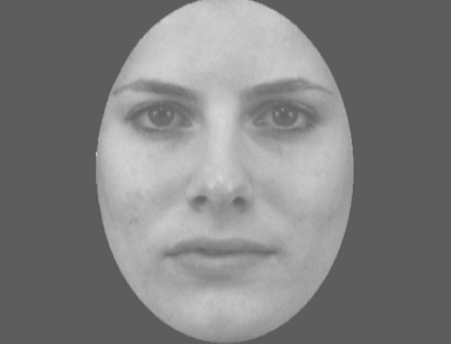

Slide 10
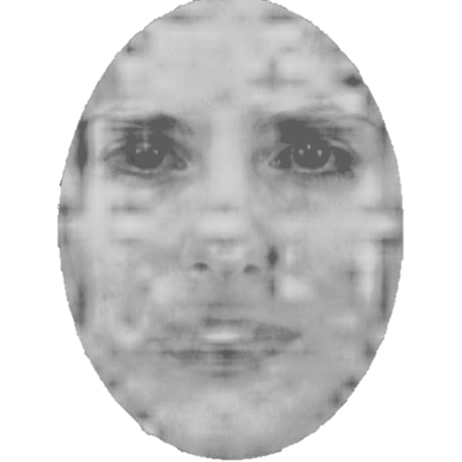

Slide 11


Slide 12
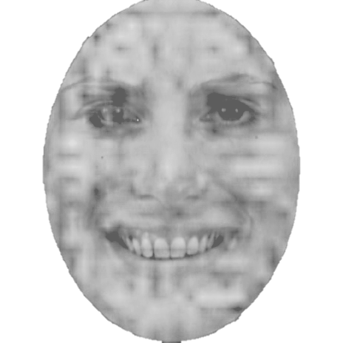

Slide 14
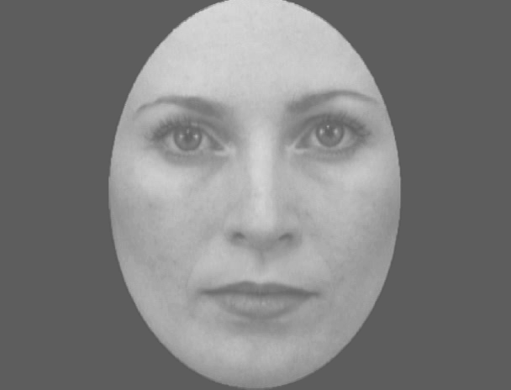

Slide 15
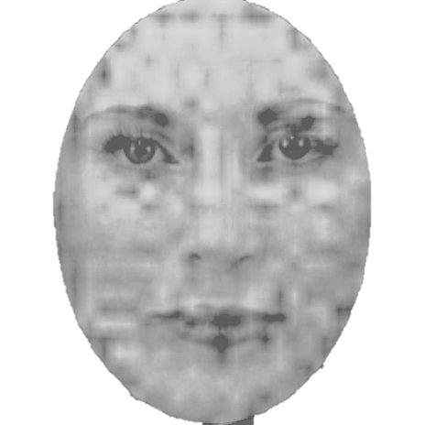

Slide 17
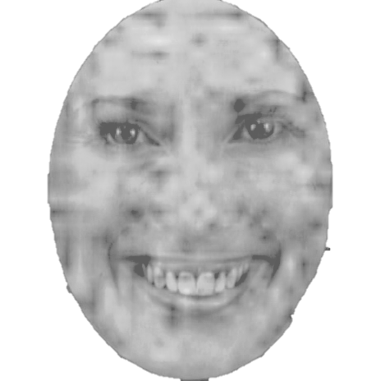

Slide 20
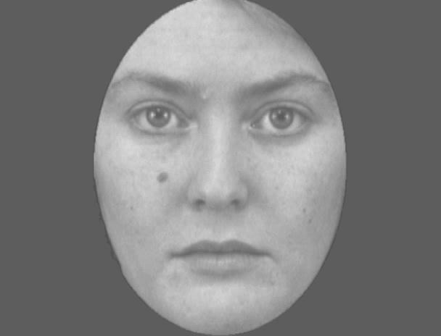

Slide 21
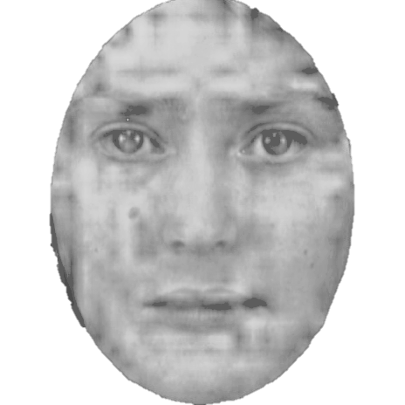

Slide 22
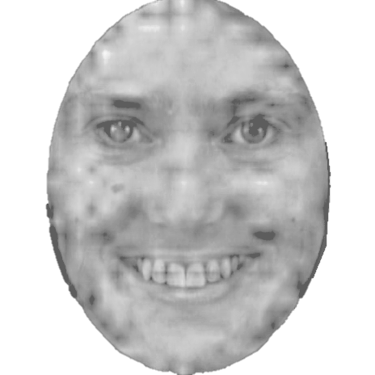

Slide 25
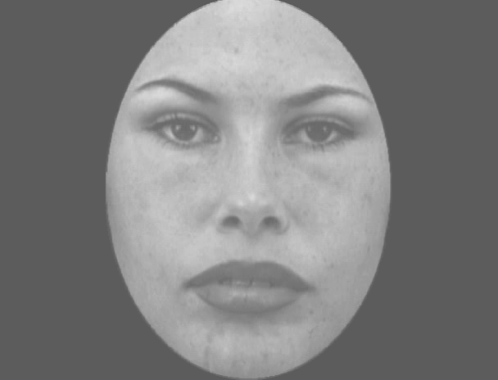

Slide 26
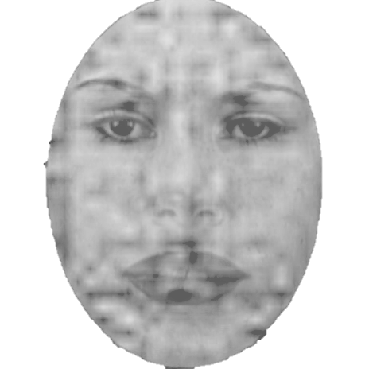

Slide 27
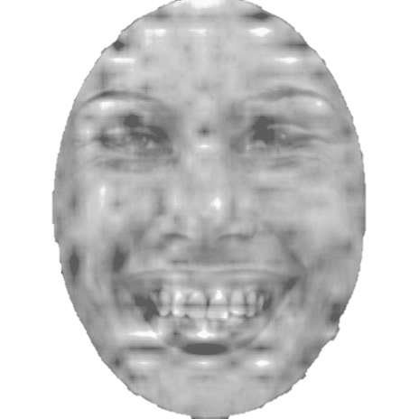

Slide 30
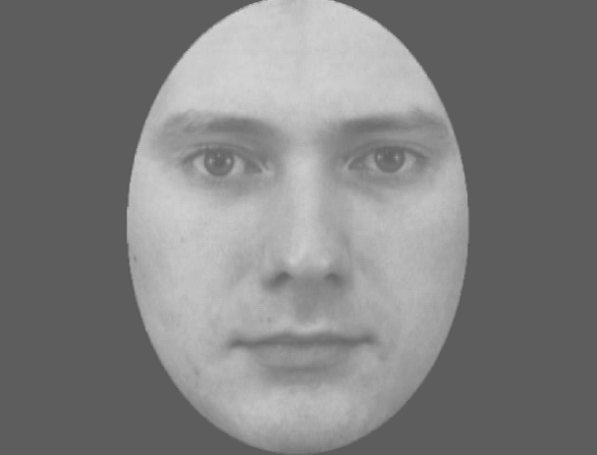

Slide 31
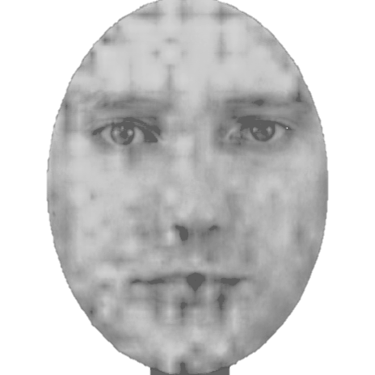

Slide 32
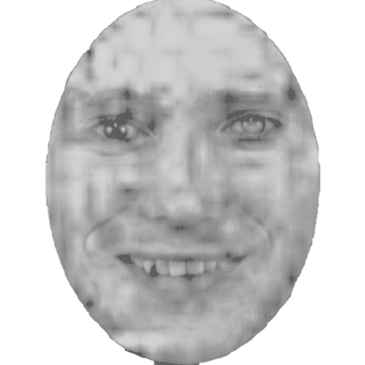

Slide 35
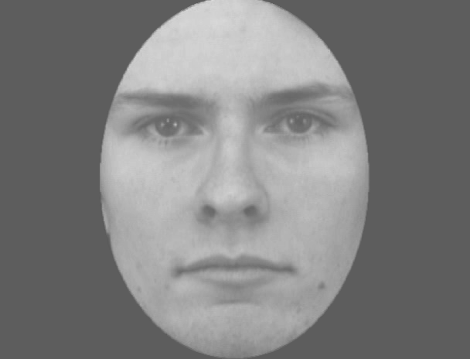

Slide 36
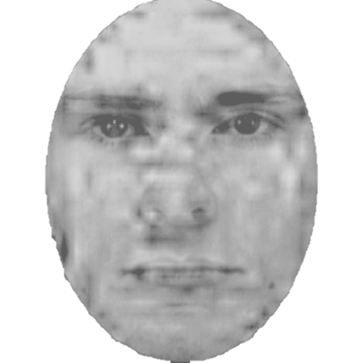

Slide 37
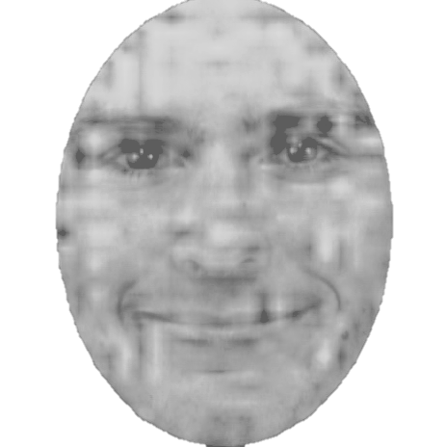

Slide 40
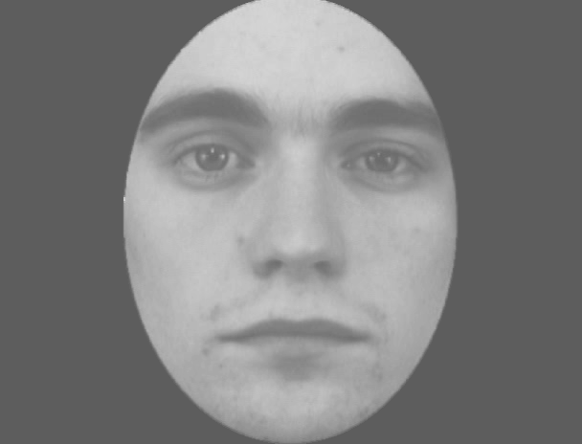

Slide 41
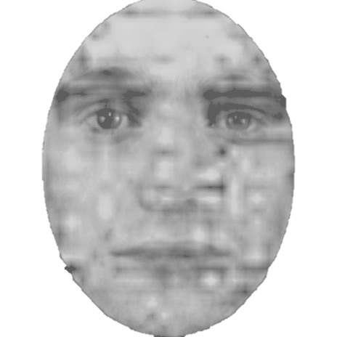

Slide 42
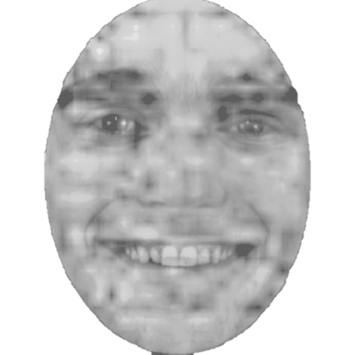

Slide 45
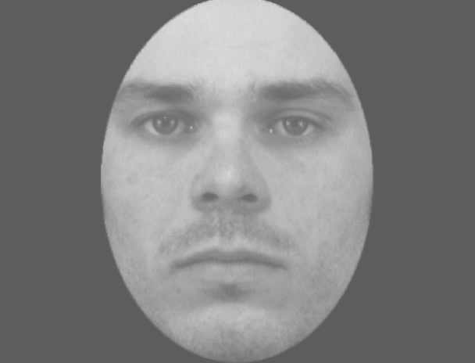

Slide 46
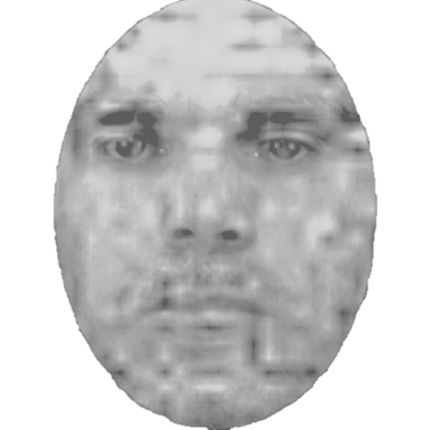

Slide 47
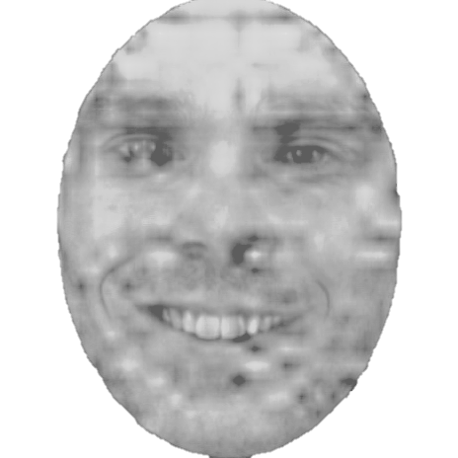

Slide 51
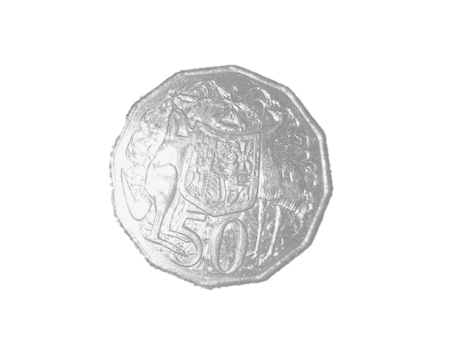

Slide 52


Slide 53
+

Slide 54
+ 1

Slide 55
- 1

